Slide 1
A linear modelling exploration of AFL scores
Trent Henderson | 20 May 2021
OLET5608

Slide 2
Agenda
Premise of and motivation for the current analysis
Available data and reputability of sources
Analytical approach and appropriateness of linear modelling
Results and implications for AFL teams
Limitations and recommendations for future analysis

Slide 3
AFL is a highly popular sport with a lack of analytics

Slide 4
Open-source work has made data readily available

Slide 5
A robust linear modelling approach was used
Data extraction from API
Data cleaning, aggregation and sense checks
Exploratory data analysis and visualisation
Linear model fitting
Final model outputs, comparative analysis, and data visualisation
Assumption checking

Slide 6
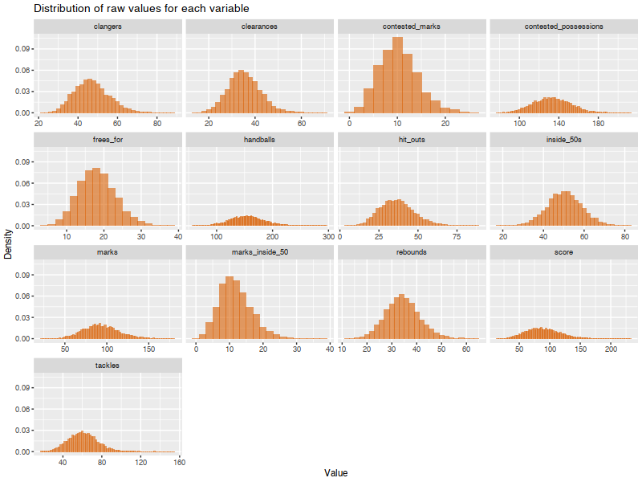
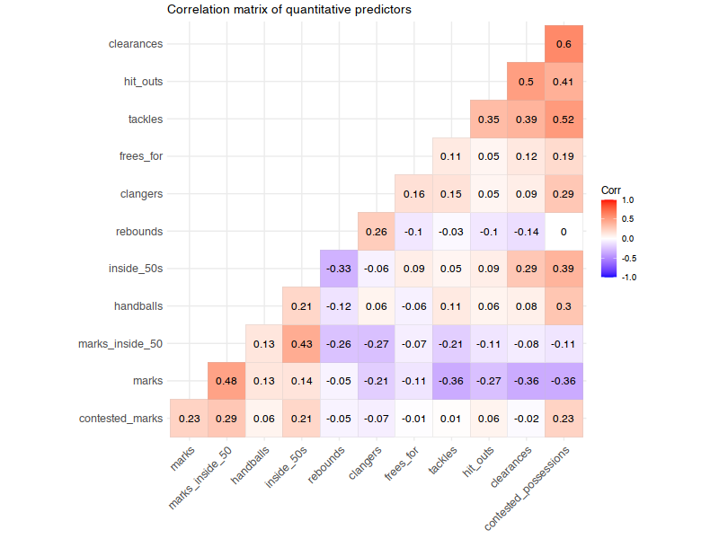
Core linear modelling assumptions were tested

Slide 7
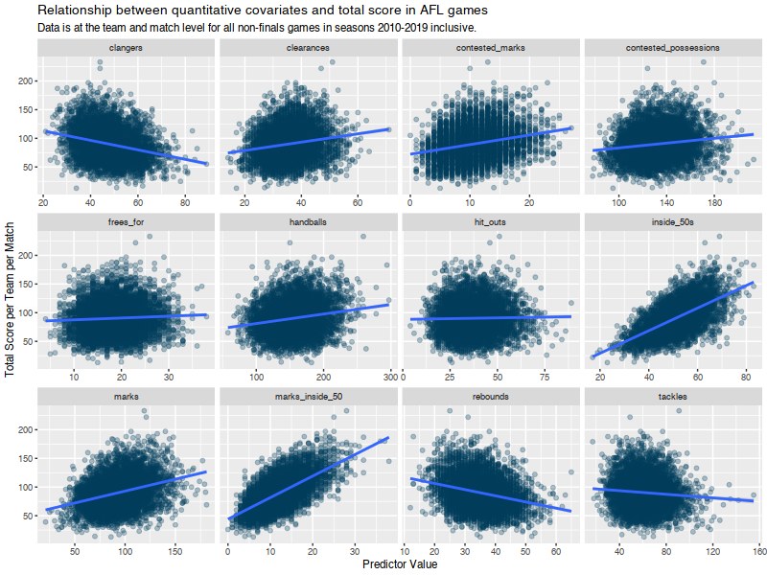
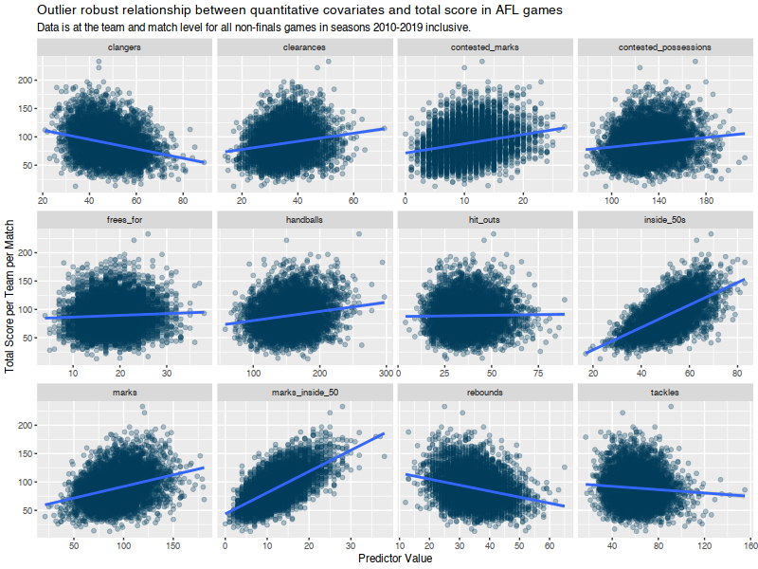
Core linear modelling assumptions were tested

Slide 8
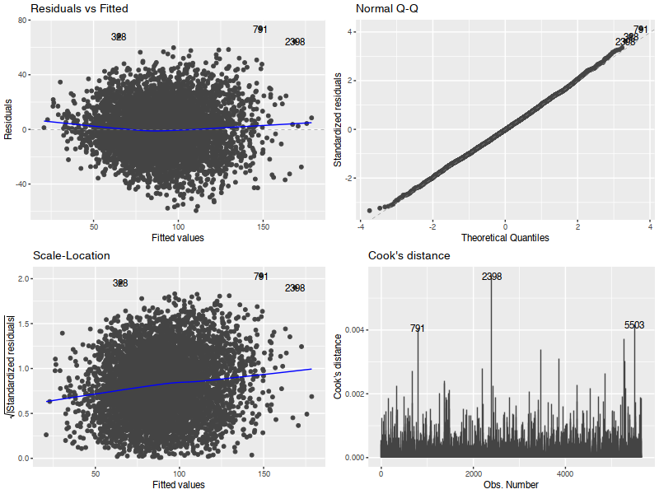
Core linear modelling assumptions were tested

Slide 9
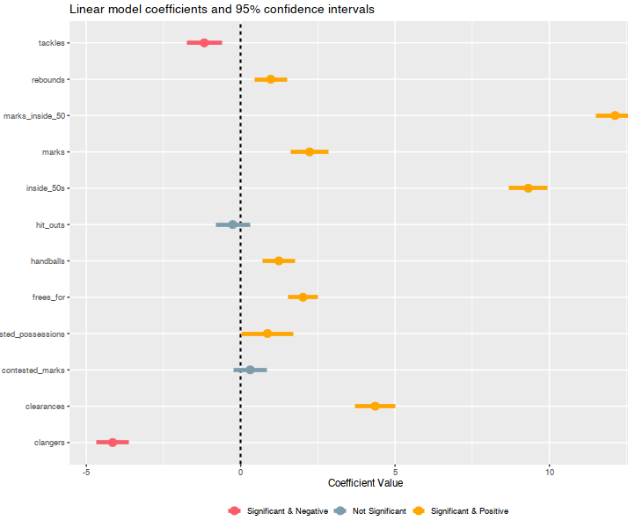
Most included game metrics could predict total score
Hit outs and contested marks did not meaningfully predict scores
Increases in tackles and unforced errors (clangers) is associated with decreases in total score
The positive coefficient of clearances is surprising given its defensive attribution
The strong positive coefficient for marks inside 50 makes sense given that these lead to controlled “set shot” attempts at goal

Slide 10
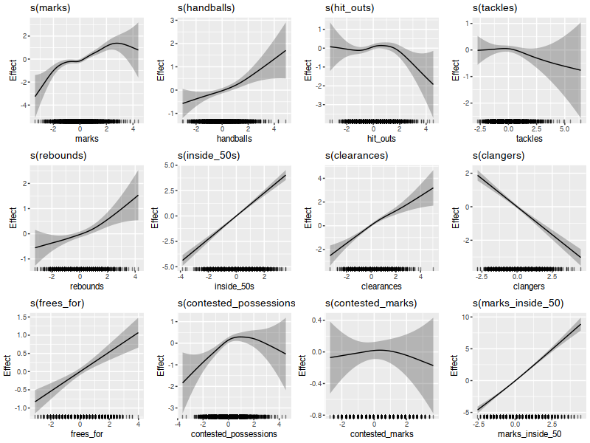
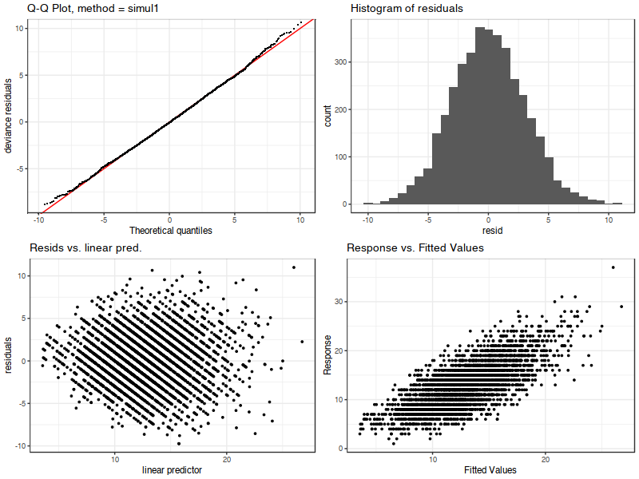
The analysis was taken further through GAMs

Slide 11
A set of limitations and solutions were identified
Not all variables in the available datasets were explored
Prior knowledge was used to select a subset of interest. Future research should examine all variables, potentially using Lasso methods
Small deviations in residuals were noted, but addition of quadratic terms did not fix it
A minor sag was noted in the residuals plot, suggesting use of a polynomial term
It remains unclear whether an ordinary least squares approach is optimal
A GAM follow-up analysis yielded superior model fit at a lower AIC
There may be differential relationships for teams
Exploring interactions may reveal unique team-level gameplay differences or a quantification of the “home team advantage”

Slide 12
Questions?

